Slide 1

Domain: Matlab
Technology: Communications
(Times New Roman, Font size : 24, Bold)
Energy Efficient Resource Allocation in Wireless Energy Harvesting Sensor Networks

Slide 2
Index (Font : Times New Roman, Font size : 24, Bold)
Abstract
Introduction
Literature Review
Existing Method
Proposed Method
Advantages
Applications
Hardware and Software Requirements
Results
Conclusion
References

Slide 3
Abstract (Font : Times New Roman, Font size : 24, Bold)
Extending the sensor life time is one of the most important issues in widespread use of Wireless Sensor Networks (WSNs). The Energy Harvesting (EH) sensors have been proposed to overcome the mentioned problem in recent years. These sensors can harvest their required energy from environment in different methods, resulting in longer life time. We consider a TDMA based Wireless Energy Harvesting Sensor Network (WEHSN) in which the time slot consists of two time intervals; the first one is utilized to absorb energy whereas the second one is used to transmit the sensors’ data. We investigate the energy efficient resource allocation in WEHSN with constraints on time scheduling parameters and transmission power consumption, where an EH sensor is allowed to transmit its data if the amount of its harvested energy is more than the consumption power. We derive the closed form expression for the optimization problem, corresponding to the energy efficiency and convert it to a parametric form, using Dinkelbach method. Then, we solve the new problem using Karush-Kuhn-Tucker (KKT) conditions. The numerical results shows the effectiveness of the proposed method.

Slide 4
Introduction: (Font : Times New Roman, Font size : 24, Bold)
It is a known fact that WSN is a resource constrained network in which energy efficiency is always the main issue since the operation of WSN depends heavily on the life span of the sensor nodes’ battery [1].
The most energy consuming operation in WSN is the data packet routing activity. The characteristics of the WSN are different from the conventional networks [2, 3].
As these wireless sensor networks has many characteristics there is a necessity to increase the lifetime of the sensor.
The efficient resource allocation like power and energy harvesting technology would extend sensors’ life time and play a major role in maximizing system performance.

Slide 5
We consider an energy efficient resource allocation in a TDMA based WEHSN.
Unlike [4], which only has optimized the network throughput, our target is to maximize the energy efficiency by decreasing the total energy consumption in the sensors.
We derive the closed form expressions for the optimization problem defined for energy efficiency and then, we apply Dinkelbach algorithm to convert the optimization problem to parametric form and find the optimal resource allocation in the network.
Using the mentioned algorithm, leads into much decrease in the energy consumption in the network, consequently, yielding better performance.

Slide 6
Literature review:(Font : Times New Roman, Font size : 24, Bold)
S. NO | Journal Type with year | Authors | Title | Outcomes
1 | IEEE Communications Magazine (2017) | J. Huang, C. Xing, and C. Wang | Simultaneous wireless information and power transfer: Technologies, applications, and research challenge | Conducted a study on SWIPT technologies and challenges in implementing it.
2 | IEEE Access, (2018) | K. Kang, R. Ye, Z. Pan, J. Liu, and S. Shimamoto, | Full-duplex wireless powered IOT networks | Maximize the total surplus energy which is the gap between available energy and consumed energy
3 | IEEE Internet of Things Journal (2018) | Z. Chu, F. Zhou, Z. Zhu, R. Q. Hu, and P. Xiao | Wireless powered sensor networks for internet of things: Maximum throughput and optimal power allocation | Proposed a quadratic energy trading based Stackelberg game, linear energy trading based Stackelberg game for better validation purpose.

Slide 7
S. NO | Journal Type with year | Authors | Title | Outcomes
4 | IEEE Transactions on Vehicular Technology, 2017 | A. Sultana, L. Zhao, and X. Fernando | Efficient resource allocation in device-to-device communication using cognitive radio technology | A two-stage approach is considered to allocate the radio resources efficiently.
5 | IEEE Communications Letters, 2016 | S. K. Nobar, K. A. Mehr, and J. M. Niya | Rf-powered green cognitive radio networks: Architecture and performance analysis | Energy transmission rate is below threshold due to access complexity

Slide 8
Existing Method
In the Internet of Things (IoT) network, where a single hybrid access point (H-AP) with a consistent power source communicates with a variety of IoT devices, wireless power transfer is a new technology that is being studied in this research. It is expected that this H-AP operates in full-duplex mode, which sends and receives signals to and from these Internet of Things devices simultaneously during the entire frame. The H-received AP's signals can be used to generate energy by the IoT devices. Additionally, the uplink transmission is supported by the energy that was captured. One Internet of Things device continues to collect energy until its own uplink time slot because uplink transmission uses time-division multiple access by utilizing the most effective time allocation strategy for each device, or uplink transmissions. To address this issue, distributed non-cooperative and bargaining cooperative game-based algorithms are developed. Additionally, the popular KKT condition technique is used as a benchmark. The numerical findings demonstrate that in terms of total surplus energy and the fairness index, the bargaining cooperative algorithm outperforms the distributed non-cooperative algorithm (DNCA) and the KKT algorithm (KKTA). In terms of overall surplus energy, DNCA performs better than KKTA, although KKTA is more equitable than DNCA

Slide 9
Disadvantages
Computationally complex.
Not reaching desired level of energy constraint.

Slide 10
Proposed method
Consider a WEHSN, which consists of one Hybrid Access Point (HAP) plugged to an infinite power supply and M sensors capable of energy harvesting.
At first, sensors harvest energy in downlink (DL) from a Wireless Energy Transferring (WET), then, they transmit information in uplink (UL) towards a Wireless Information Transmission (WIT). The total time interval for energy harvesting and information transmission is denoted by Tmax.
During DL WET and transmit information in duration of UL WIT. The second interval is divided into M slots belonging to each sensor. The perfect Channel State Information (CSI) is assumed to be available in each sensor for resource allocation.

Slide 11
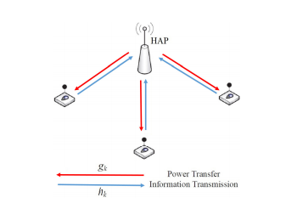
The system modal is given as follows:
Figure: System modal of proposed method

Slide 12
During the uplink period, due to TDMA-based WEHSN, each sensor transmits information in allocated time slot.
Therefore, the consumed energy in each sensor during the information transmission will be equal to the sum of power allocated for sensor i in WIT and the circuit power consumption in information transmission period.
Same as in downlink period, the energy is restricted to certain limited using our process.
These uplink and downlink process utilizes Dinkelbach Algorithm in order to increase the energy efficiency.
After consideration of system modal, lagrangian functions based algorithms are used for allocating resources using KarushKuhn-Tucke conditions.

Slide 13
Time-division multiple access (TDMA) is a channel access method for shared-medium networks.
It allows several users to share the same frequency channel by dividing the signal into different time slots.
The users transmit in rapid succession, one after the other, each using its own time slot.
This method is used to increase the throughput of overall system and it also used to increase the energy efficiency.

Slide 14
Advantages
Increase the through put.
Reduces complexity and increase the efficiency in energy.

Slide 15
Software requirements
Matlab 2018 a or above versions

Slide 16
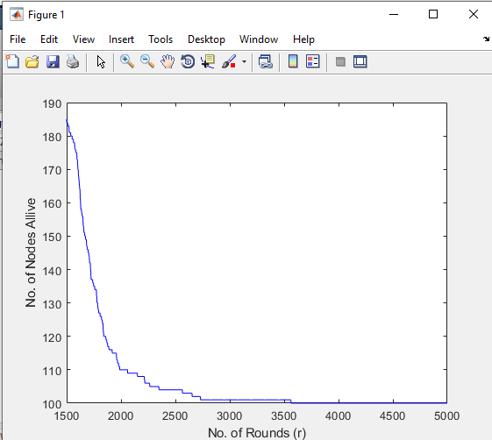
Results

Slide 17
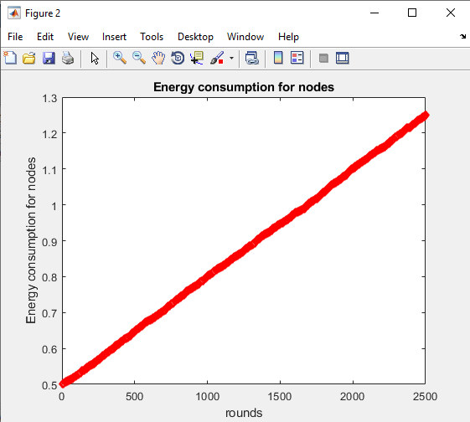

Slide 18
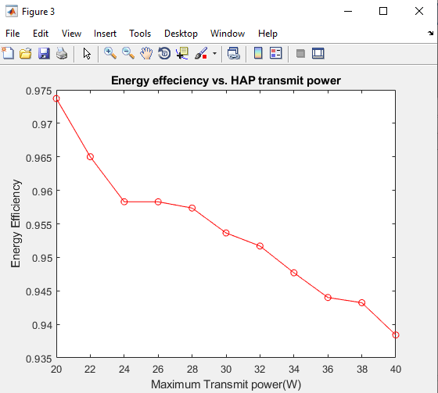

Slide 19
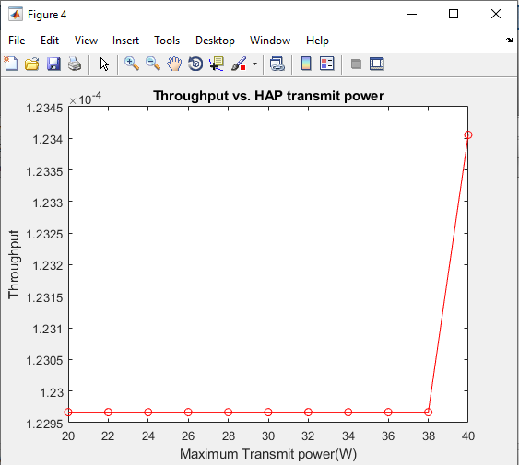

Slide 20
Conclusion
In this paper, we propose a new system model in which the wireless sensors use the harvest-then-transmit protocol to harvest the required energy for data transmission. Also, the sensors use TDMA in the remaining time interval to communicate with a Hybrid Access Point. We derive the optimization problem for energy efficiency as the system performance applying the constraints on the time schedule parameter and transmission power for each sensor. We use Dinkelbach algorithm to solve the problem and obtain the closed form expressions. The numerical results show that although the throughput could see a little decrease in comparision to the other methods, the energy consumption would decline much more to that of the other methods, resulting in the better energy efficiency as the performance of the network.

Slide 21
References
[1] K. Kaur and B. Singh, “Wireless sensor network based: design principles & measuring performance of IDS,” International Journal of Computer Applications, vol. 1, no. 28, pp. 94–99, 2010.
[2] I. F. Akyildiz, W. Su, Y. Sankar Subramaniam, and E. Cayirci, “A survey on sensor networks,” IEEE Communications Magazine, vol. 40, no. 8, pp. 102–105, 2002.
[3] M. Chu, H. Haussecker, and F. Zhao, “Scalable information-driven sensor querying and routing for ad hoc heterogeneous sensor networks,” International Journal of High Performance Computing Applications, vol. 16, no. 3, pp. 293–313, 2002.

Slide 22
[4] J. Huang, C. Xing, and C. Wang, “Simultaneous wireless information and power transfer: Technologies, applications, and research challenges,” IEEE Communications Magazine, vol. 55, no. 11, pp. 26–32, Nov 2017.
[5] K. Kang, R. Ye, Z. Pan, J. Liu, and S. Shimamoto, “Full-duplex wireless powered iot networks,” IEEE Access, vol. 6, pp. 53 546–53 556, 2018.
[6] Z. Chu, F. Zhou, Z. Zhu, R. Q. Hu, and P. Xiao, “Wireless powered sensor networks for internet of things: Maximum throughput and optimal power allocation,” IEEE Internet of Things Journal, vol. 5, no. 1, pp. 310–321, Feb 2018.
[7] A. Sultana, L. Zhao, and X. Fernando, “Efficient resource allocation in device-to-device communication using cognitive radio technology,” IEEE Transactions on Vehicular Technology, vol. 66, no. 11, pp. 10 024– 10 034, Nov 2017.
[8] S. K. Nobar, K. A. Mehr, and J. M. Niya, “Rf-powered green cognitive radio networks: Architecture and performance analysis,” IEEE Communications Letters, vol. 20, no. 2, pp. 296–299, Feb 2016.

